Slide 1


Social Buzz

Slide 2


Today's agenda
Project recap
Problem
The Analytics team
Process
Insights
Summary

Slide 3

Social Buzz, a rapidly expanding technology unicorn, must swiftly adjust to its global presence. Accenture has launched a three-month proof of concept (POC) centered
on the following objectives:
Conducting an audit of Social Buzz’s big data practices
Providing recommendations for a successful IPO
Analyzing data to identify the top five most popular content categories on the platform
Project Recap

Slide 4


Problem
Over 100,000 posts per day
36,500,000 pieces of Content per year
But how to capitalize on it when there is so much ?
Analysis to find Social Buzz’s top 5 most popular categories of content

Slide 5



Andrew Fleming (Chief Technical Architect)
The Analytics team
Marcus Rompton (Senior Principle)
Me (Data Analyst)

Slide 6
Process
1
Data Understanding
Data Cleaning
2
Data Modelling
3
4
Data Analysis
5
Uncover Insights

Slide 7

Insights
16
January
1897
Reactions to the most popular category “Animal”
Unique categories
Is the month with most uploads

Slide 8
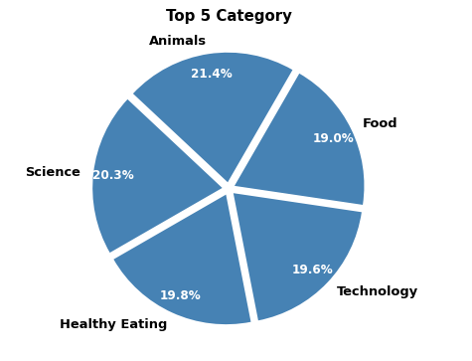

Slide 9
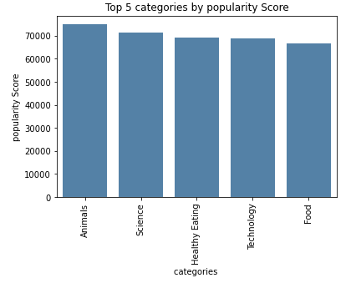

Slide 10

Animals, Science are the most popular categories, indicating that users are drawn to real-life and factual content.
The strong interest in Healthy Eating suggests a potential opportunity to collaborate with healthy food brands to boost user engagement.
Users also show a keen interest in Technology, meaning a campaign focused on emerging technologies could effectively drive engagement on the platform.
Summary

Slide 11

Thank you!
ANY QUESTIONS?

